Slide 1
Data Visualization
Happy Planet index Presentation
John Taden

Slide 2
Happy Planet index
Objective1:
To plot Happy Planet Index against Happy Life Years.
Research Question:
Does number of Happy Life Years correlate with the Happy Planet Index?
2. If so, which regions demonstrate a higher correlation?

Slide 3
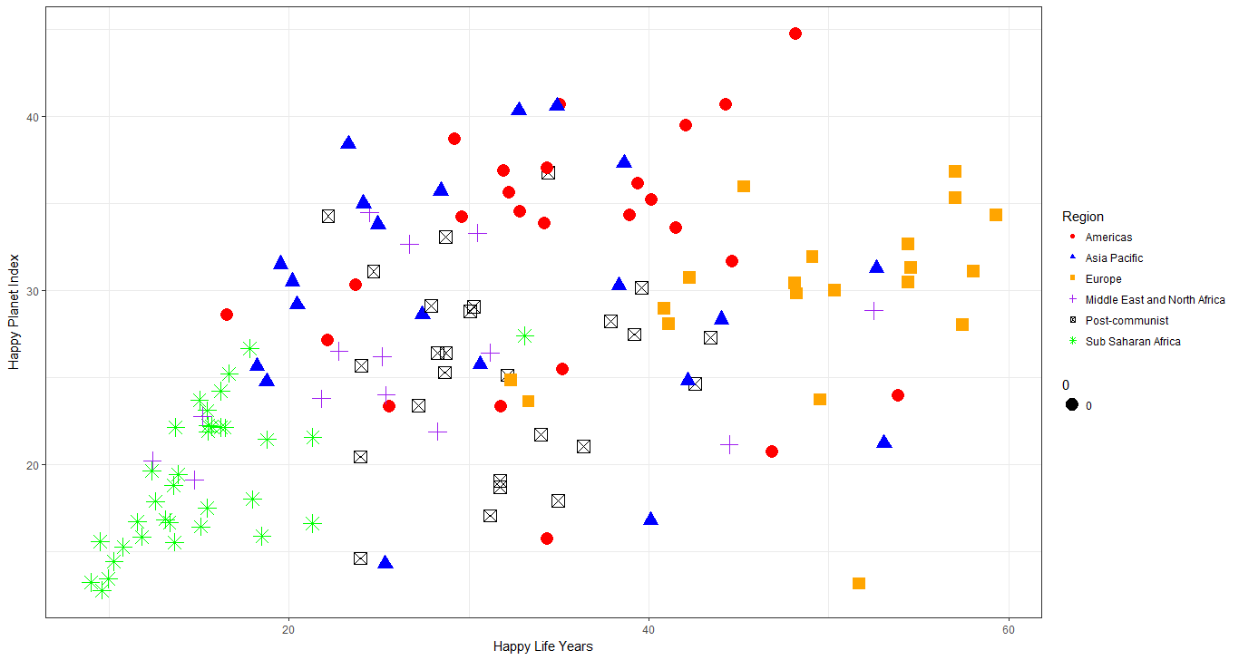
Happy Planet index

Slide 4
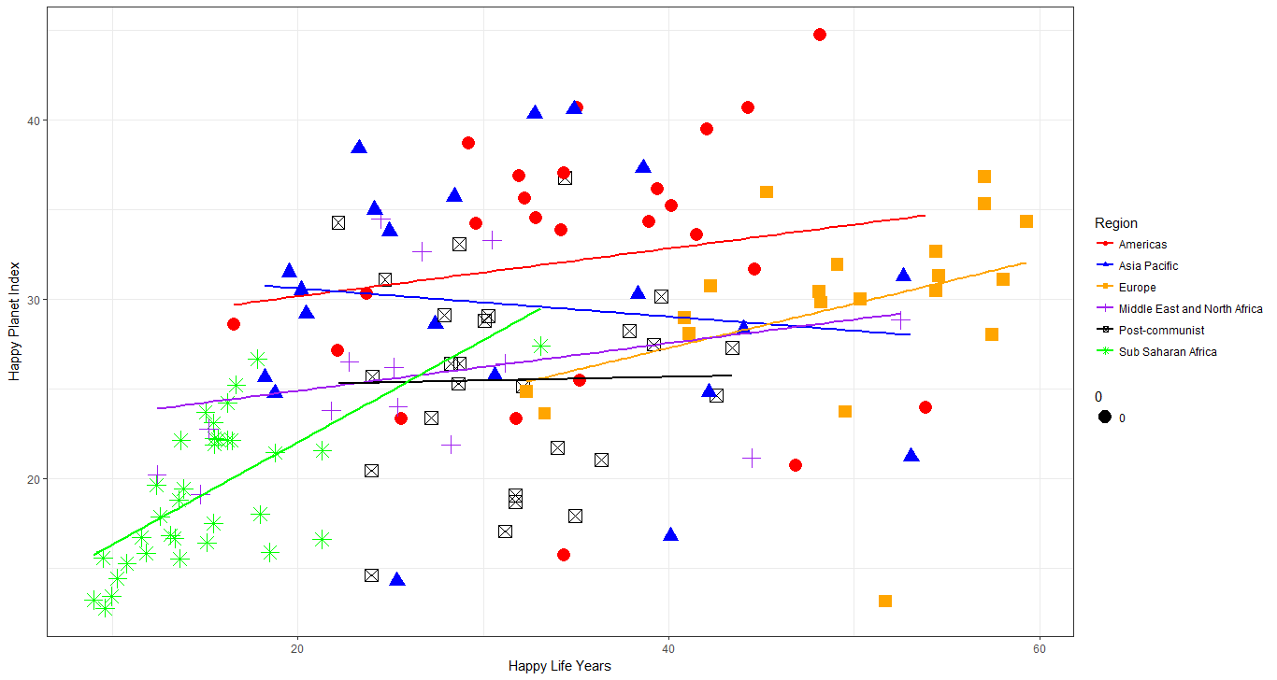
Happy Planet index

Slide 5
Happy Planet index
Objective2:
To visualize regional rankings.
Research Question:
Which regions of the world rank the highest in the HPI?

Slide 6
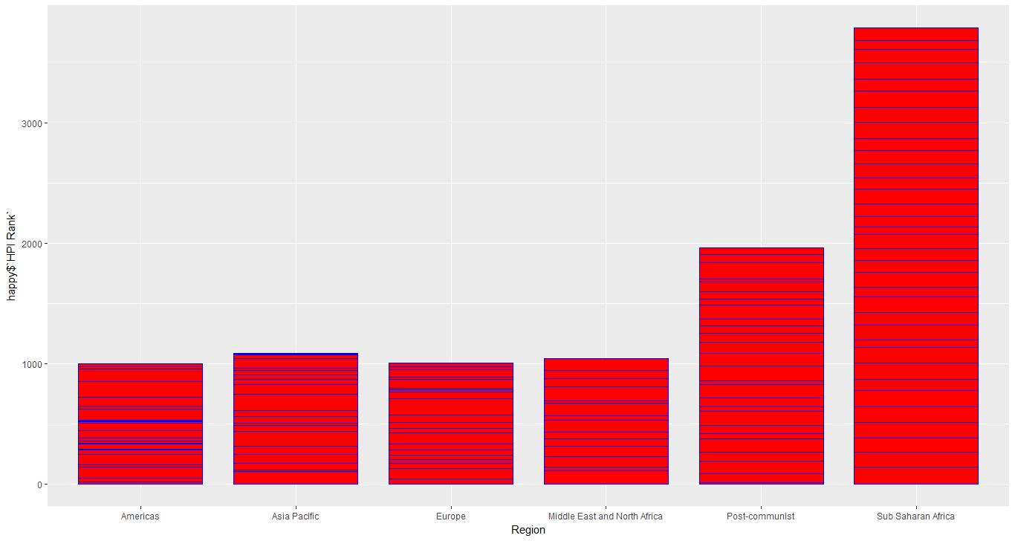
Happy Planet index
The shorter the bar the higher the rank

Slide 7
Happy Planet index
Rcode:
happy=read_excel("C:/Users/Nika/Dropbox/Data Visualization/R works/hpi-data-2016-update.xlsx")
#Make Region a factor variable)
happy$Region = factor(happy$Region)
scatter2 = ggplot(happy, aes(happy$`Happy Life Years`, happy$`Happy Planet Index`, color = Region))
scatter2 +
geom_point(aes(shape=Region, size = .0)) +
geom_smooth(method = "lm", aes(fill = Region), alpha = .0) +
xlab("Happy Life Years") +
ylab("Happy Planet Index") +
theme_bw() +
scale_fill_manual(values = c("red", "blue", "orange", "purple", "black", "green")) +
scale_color_manual(values = c("red", "blue", "orange", "purple", "black", "green"))

Slide 8
Happy Planet index
Rcode:
bar1<- ggplot(happy, aes(x=Region, y=happy$`HPI Rank`)) +
bar1 +
geom_bar(color="blue", fill="red", width=0.8, stat="identity") +
xlab("Region") +
ylab("Rank") +
ggtitle("Regional Ranking")

